Slide 1
ENGR 1330 Computational Thinking with Data Science 10. Causality – Iteration & Simulation Turgut Batuhan Baturalp, (Dr. Batu) Whitacre College of Engineering Texas Tech University

Slide 2
Topic Outline
Causality
Iteration
Simulation

Slide 3
Objectives
To understand the fundamental concepts involved in establishing causality.
To understand the fundamental concepts involved in iteration.
To understand the fundamental concepts involved in simulation.

Slide 4
Computational Thinking Concepts
Causality
Iteration
Simulation
Algorithm design
Creating Computational
Models
Iteration
Simulation

Slide 5
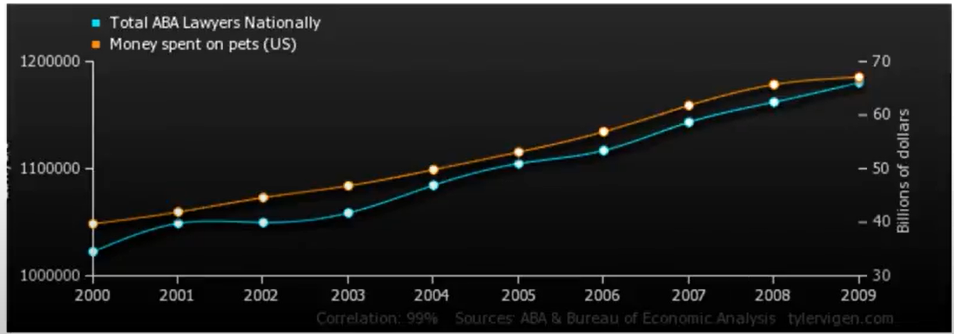
Causality
Humans tend to find patterns in information and like to think casually. The general formation of causality is “with this, therefore because of this”.
Correlation doesn’t always mean causality.
https://www.youtube.com/watch?v=1Sa2v7kVEc0

Slide 6
Causality
Most of the research questions attempt to assign a cause to an effect.
A careful examination of data can help shed light on these questions.
In data science, many such studies involve observations on a group of individuals, a factor of interest called a treatment, and an outcome measured on each individual.
The establishment of causality often takes place in two stages.
First, an association is observed. Any relation between the treatment and the outcome is called an association.
Next, a more careful analysis leads to a decision about causality.

Slide 7
Establishing Causality & Randomization
Attempt to control all variables other than the suspected variables
Hard to do
Establish randomized control studies
Start with a population
Randomly assign members to either
Control group
Treatment group
Conduct experiment to two groups identically, except one variable being evaluated
Hard to do

Slide 8
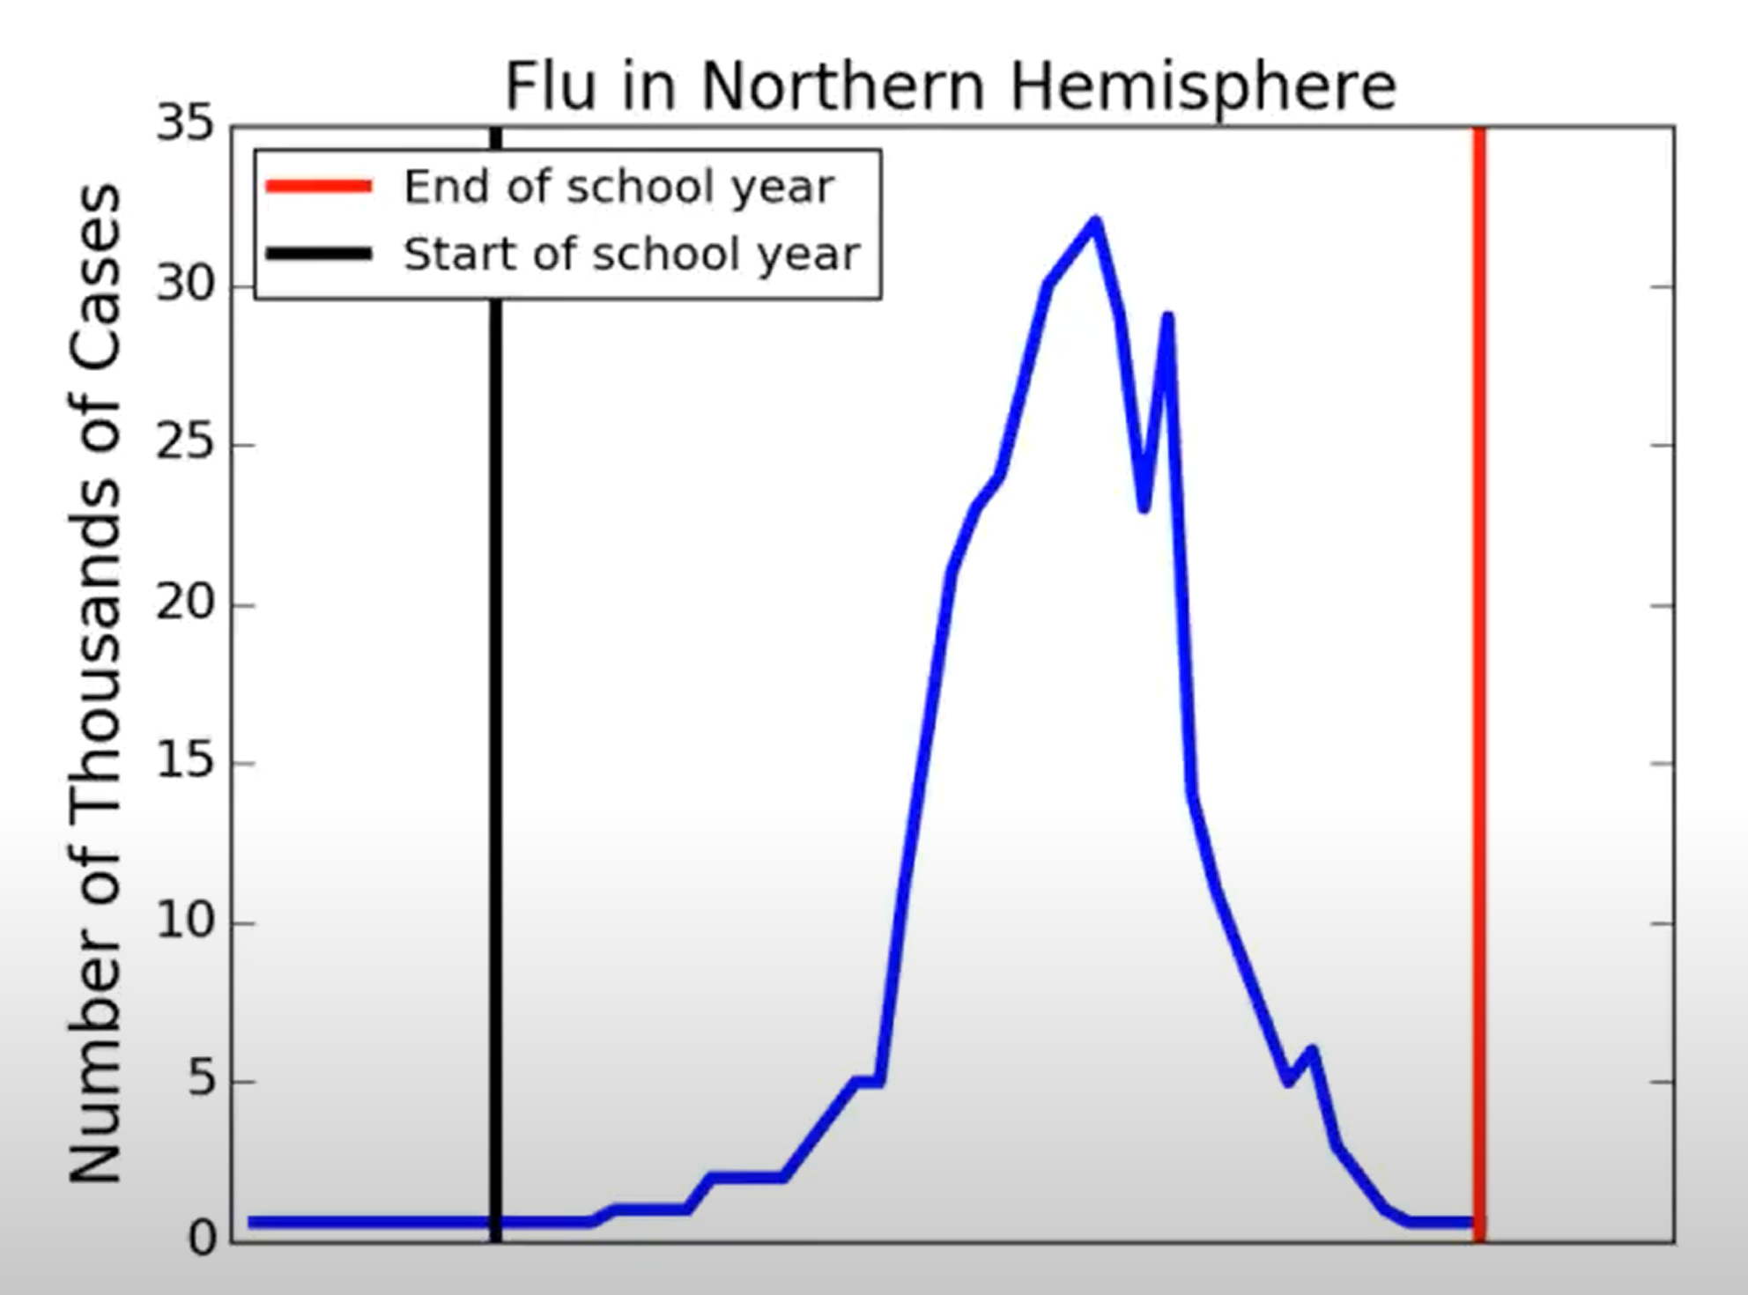
Example: Flu & School Attendance

Slide 9
Example: Flu & School Attendance
Research Question:
Does going to school contribute to the spread of flu?
Or Does the spread of flu contribute to the school attendance?
Or is there another variable that affects both? This can be called as “confounding factor” or “lurking variable”.
Cold weather?, more indoor time?, more interaction?
Hard to tell based on this data.

Slide 10
Confounding factors
An underlying difference between the two groups (other than the treatment) is called a confounding factor, because it might confound you (that is, mess you up) when you try to reach a conclusion.
For example, Cold weather in the previous example and Coffee and lung cancer.
Notes:
Example: Coffee and lung cancer. Studies in the 1960’s showed that coffee drinkers had higher rates of lung cancer than those who did not drink coffee. Because of this, some people identified coffee as a cause of lung cancer. But coffee does not cause lung cancer. The analysis contained a confounding factor—smoking. In those days, coffee drinkers were also likely to have been smokers, and smoking does cause lung cancer. Coffee drinking was associated with lung cancer, but it did not cause the disease.

Slide 11
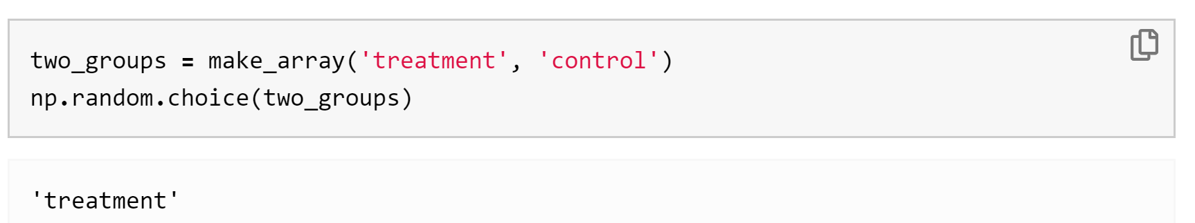
Randomness
To establish causality in our experiments, we need randomization.
We will use Python to make random choices. There are built-in functions in numpy library under random submodule.
choice function randomly picks one item from an array.
np.random.choice(array_name), where array_name is the name of the array from which to make the choice.
Notes:
Example: Coffee and lung cancer. Studies in the 1960’s showed that coffee drinkers had higher rates of lung cancer than those who did not drink coffee. Because of this, some people identified coffee as a cause of lung cancer. But coffee does not cause lung cancer. The analysis contained a confounding factor—smoking. In those days, coffee drinkers were also likely to have been smokers, and smoking does cause lung cancer. Coffee drinking was associated with lung cancer, but it did not cause the disease.

Slide 12
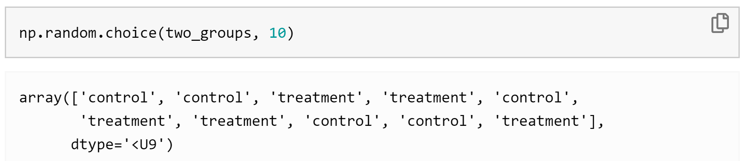
Randomness
The difference of this function from others that we learned so far, is that it doesn’t give the same result every time.
We can roll a dice using this function by randomly selecting from an array from 1 to 6.
Notes:
Example: Coffee and lung cancer. Studies in the 1960’s showed that coffee drinkers had higher rates of lung cancer than those who did not drink coffee. Because of this, some people identified coffee as a cause of lung cancer. But coffee does not cause lung cancer. The analysis contained a confounding factor—smoking. In those days, coffee drinkers were also likely to have been smokers, and smoking does cause lung cancer. Coffee drinking was associated with lung cancer, but it did not cause the disease.

Slide 13
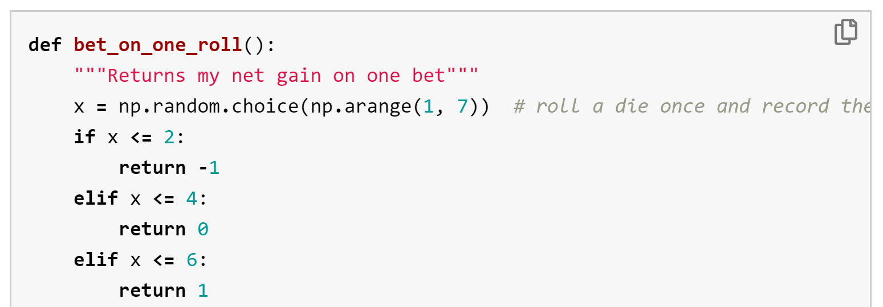
Iteration
We might need to repeat a process multiple times to reach better results or cover more results.
Let’s create a game with following rules:
If the dice shows 1 or 2 spots, my net gain is -1 dollar.
If the dice shows 3 or 4 spots, my net gain is 0 dollars.
If the dice shows 5 or 6 spots, my net gain is 1 dollar.

Slide 14
Iteration
A more automated solution is to use a for statement to loop over the contents of a sequence. This is called iteration.
A more automated solution is to use a for statement to loop over the contents of a sequence. Each result is called iteration.
Here we use a for statement in a more realistic way: we print the results of betting five times on the die as described earlier.
This is called simulating the results of five bets. We use the word simulating to remind ourselves that we are not physically rolling dice and exchanging money but using Python to mimic the process.

Slide 15
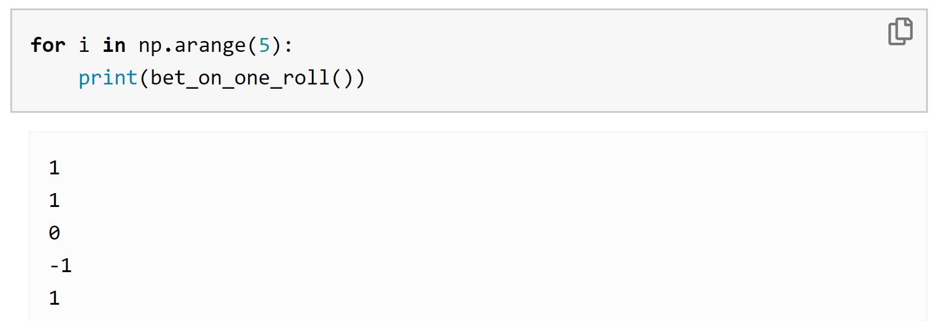
Iteration – Example 1
To repeat a process n times, it is common to use the sequence np.arange(n) in the for statement. It is also common to use a very short name for each item. In our code we will use the name i to remind ourselves that it refers to an item.
we perform exactly the same (random) action several times, so the code does not actually refer to i.

Slide 16
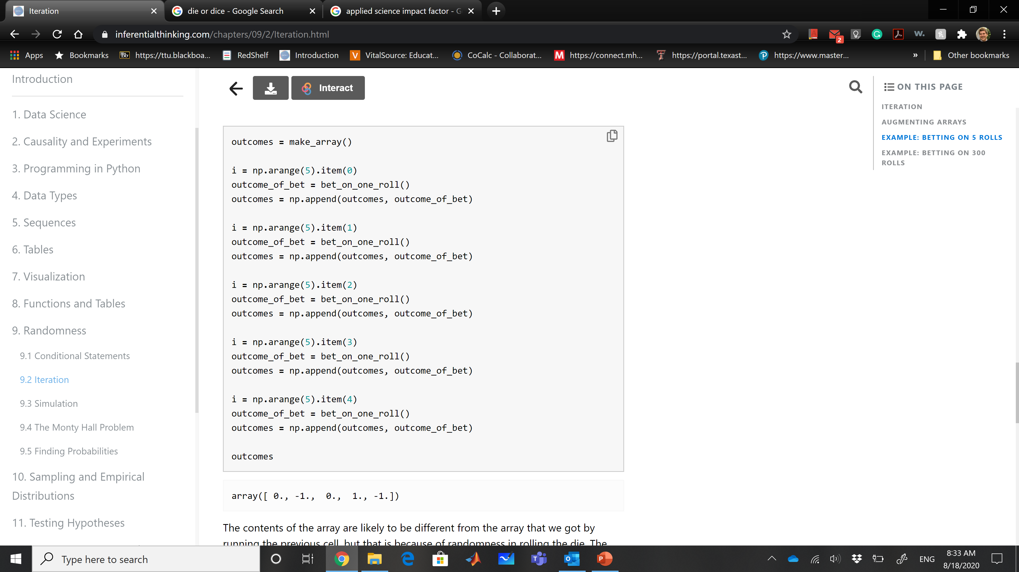
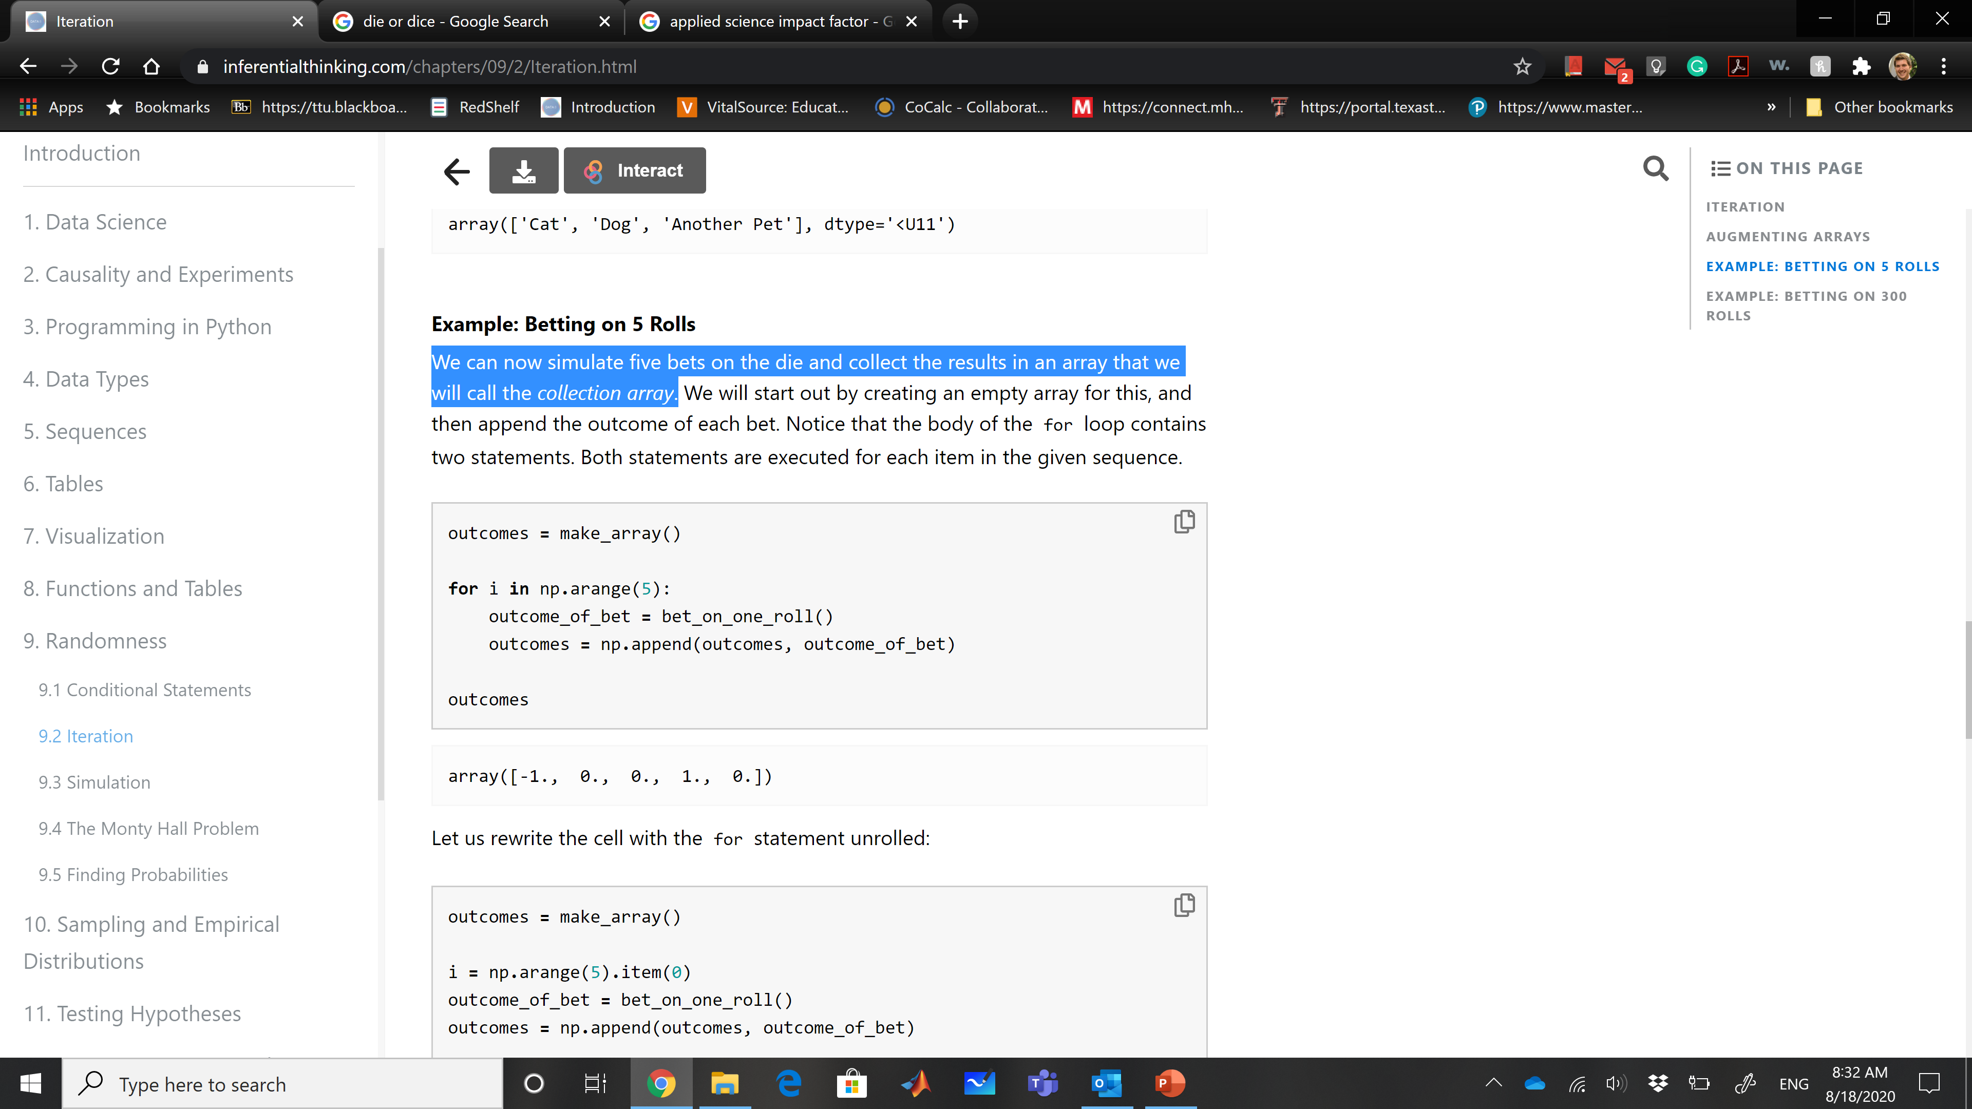
Iteration – Example 2
We can now simulate five bets on the dice and collect the results in an array that we will call the collection array.

Slide 17
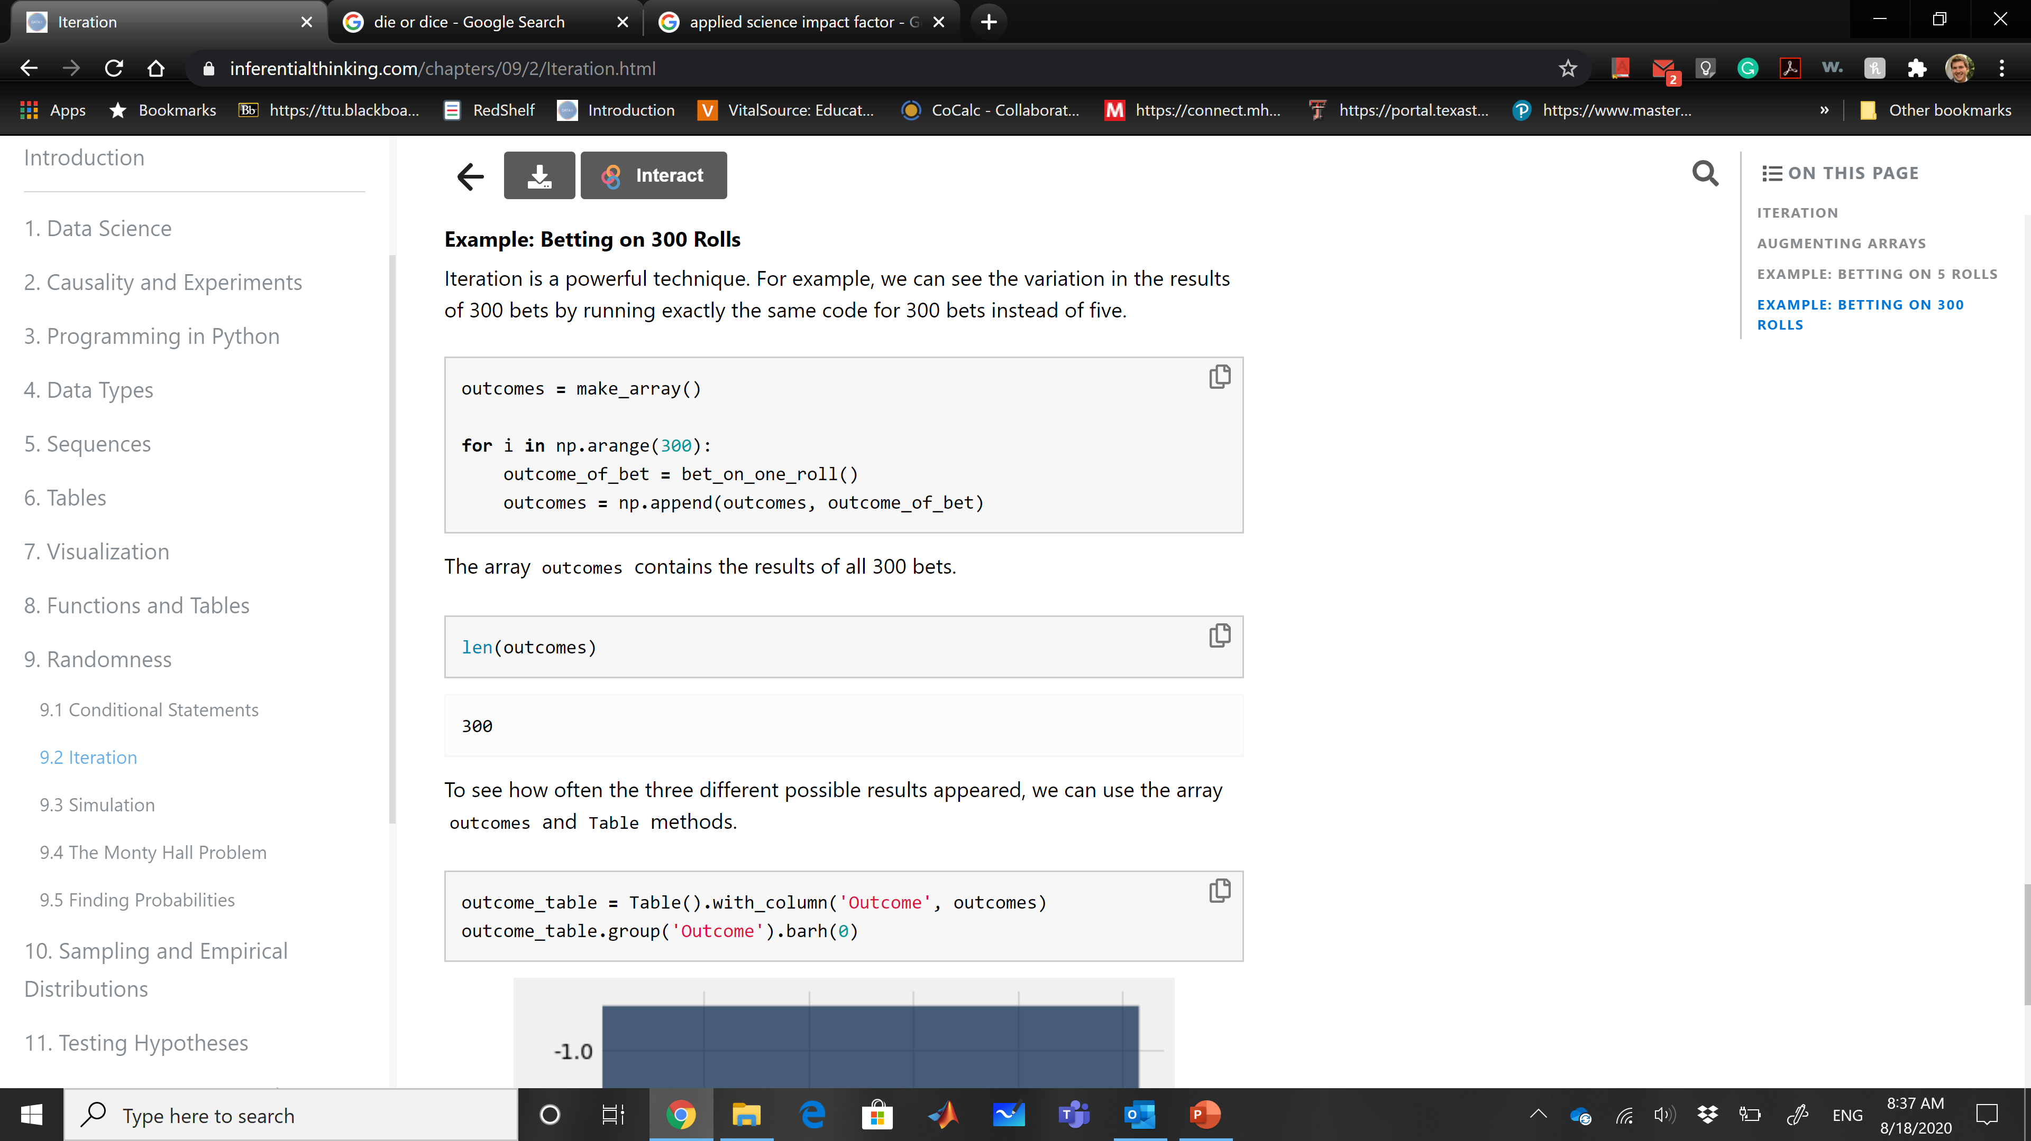
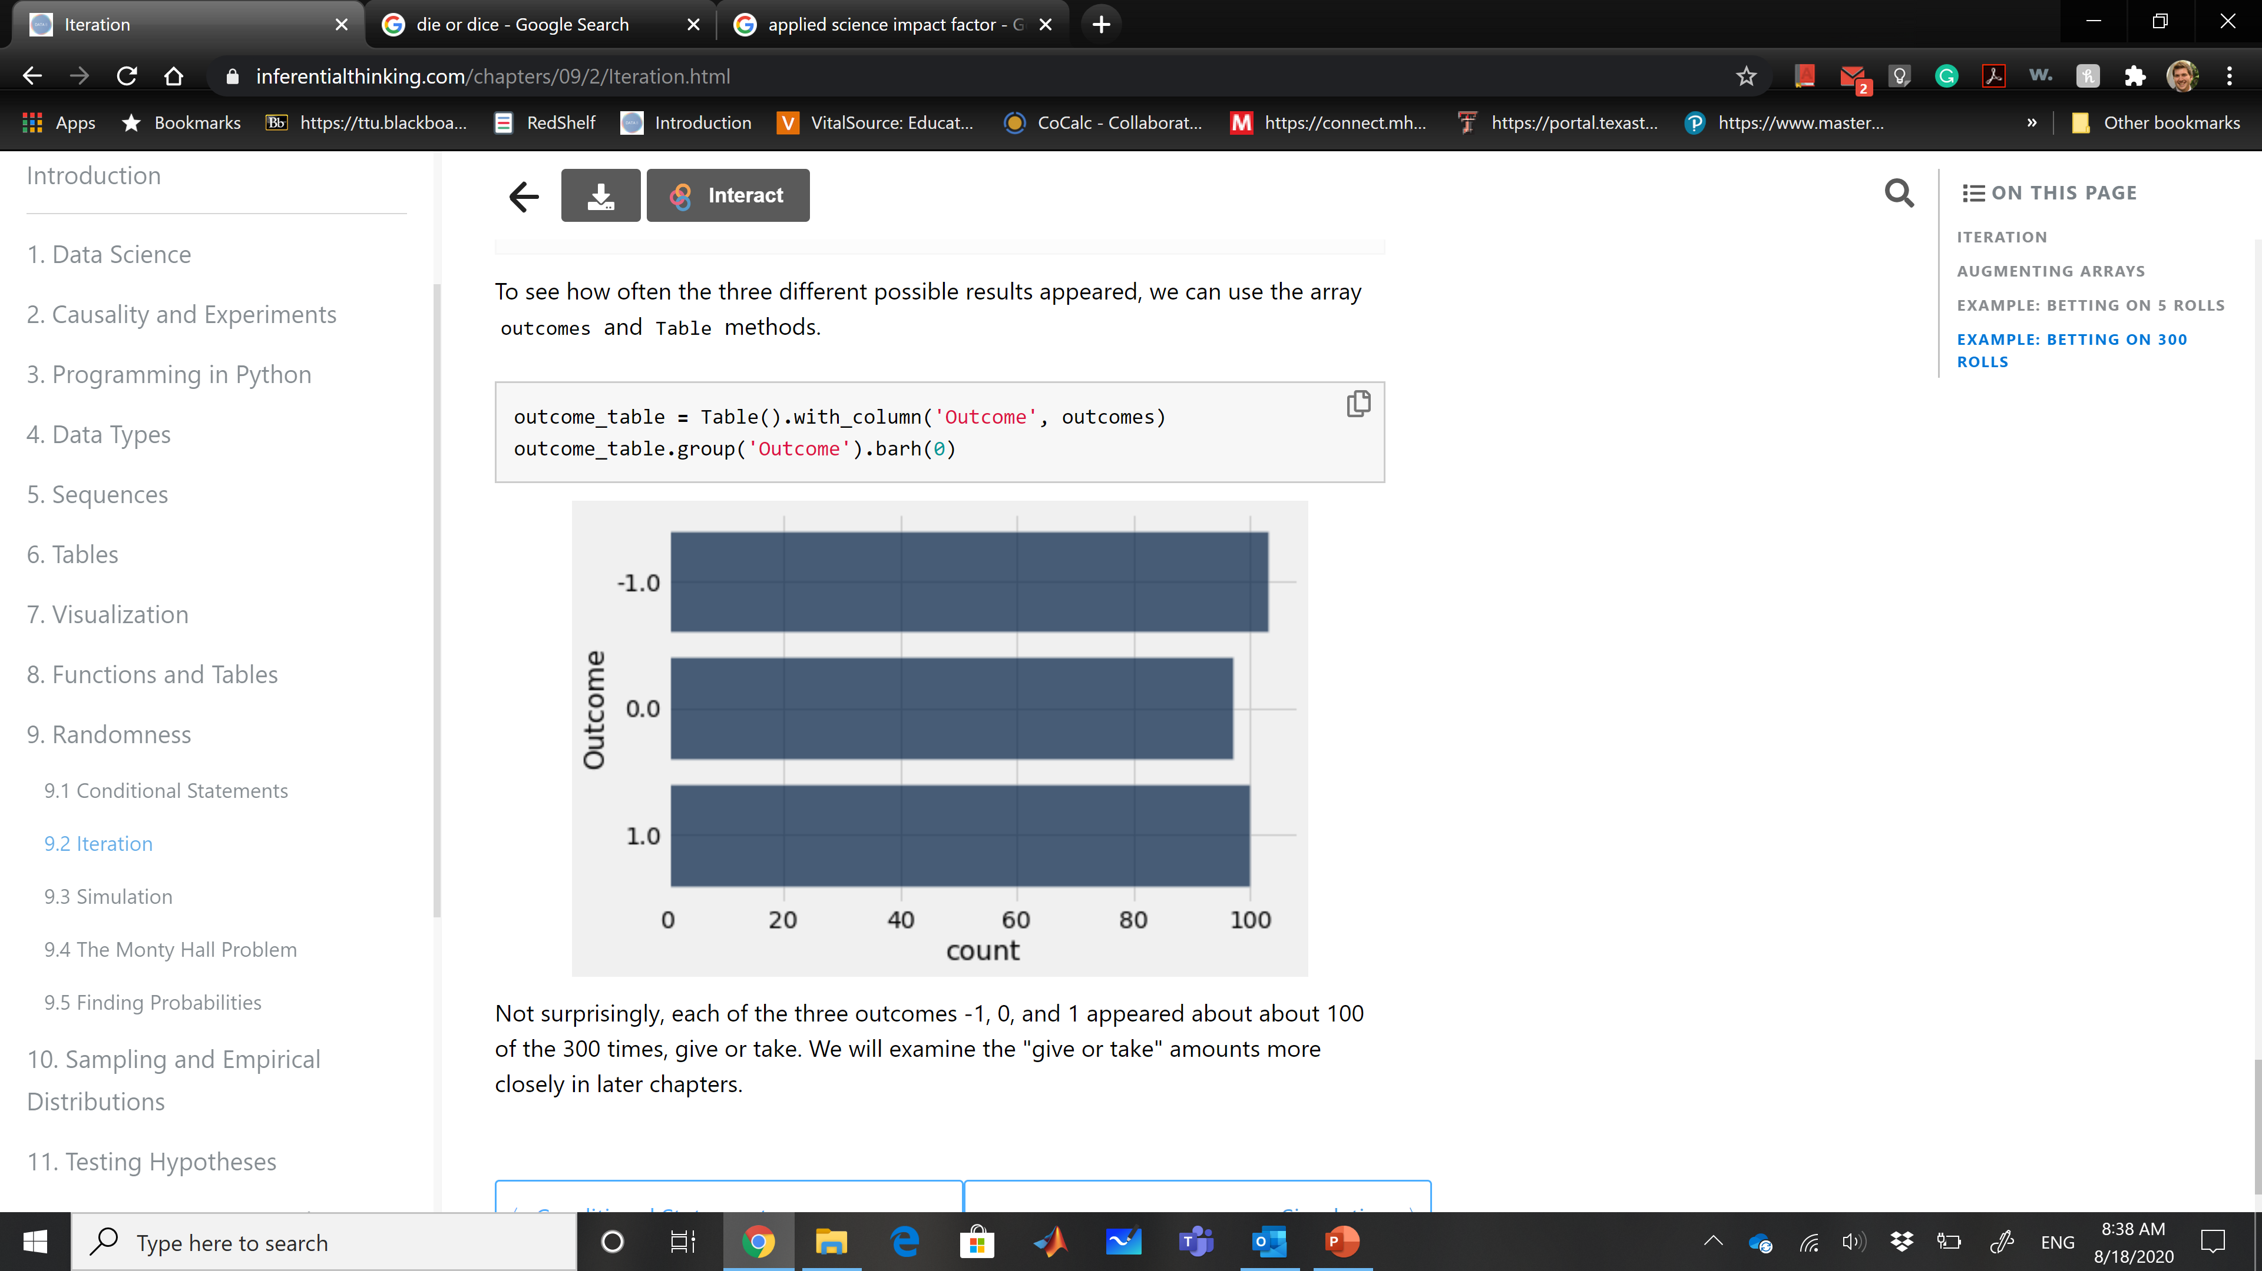
Iteration – Example 3
We can see the variation in the results of 300 bets by running exactly the same code for 300 bets instead of five.

Slide 18
Simulation
Simulation is the process of using a computer to mimic a physical experiment. In this class, those experiments will almost invariably involve chance.
Step 1: What to Simulate: Specify the quantity you want to simulate. For example, you might decide that you want to simulate the outcomes of tosses of a coin.
Step 2: Simulating One Value: Figure out how to simulate one value of the quantity you specified in Step 1.
Step 3: Number of Repetitions: Decide how many times you want to simulate the quantity. You will have to repeat Step 2 that many times.
Step 4: Coding the Simulation: Put it all together in code.

Slide 19
Step 4: Coding the Simulation
Create an empty array in which to collect all the simulated values. We will call this the collection array.
Create a "repetitions sequence," that is, a sequence whose length is the number of repetitions you specified in Step 3. For n repetitions we will almost always use the sequence np.arange(n).
Create a for loop. For each element of the repetitions sequence: Simulate one value based on the code you developed in Step 2.
Augment the collection array with this simulated value.
That's it! Once you have carried out the steps above, your simulation is done. The collection array contains all the simulated values.

Slide 20
Simulation Example
The Monty Hall simulation is derived from "Let's Make a Deal“ TV show and became famous in Game Theory.
The setting is a game show in which the contestant is faced with three closed doors. Behind one of the doors is a fancy car, and behind each of the other two there is a goat. Rules are (https://en.wikipedia.org/wiki/Monty_Hall_problem):
The contestant makes an initial choice, but that door isn't opened.
At least one of the other two doors must have a goat behind it.
There are two doors left, one of which was the contestant's original choice. One of the doors has the car behind it, and the other one has a goat. The contestant now gets to choose which of the two doors to open.

Slide 21
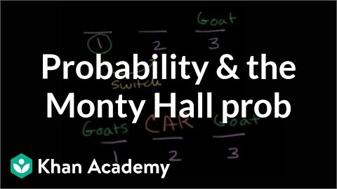
Simulation Example
https://youtu.be/Xp6V_lO1ZKA

Slide 22
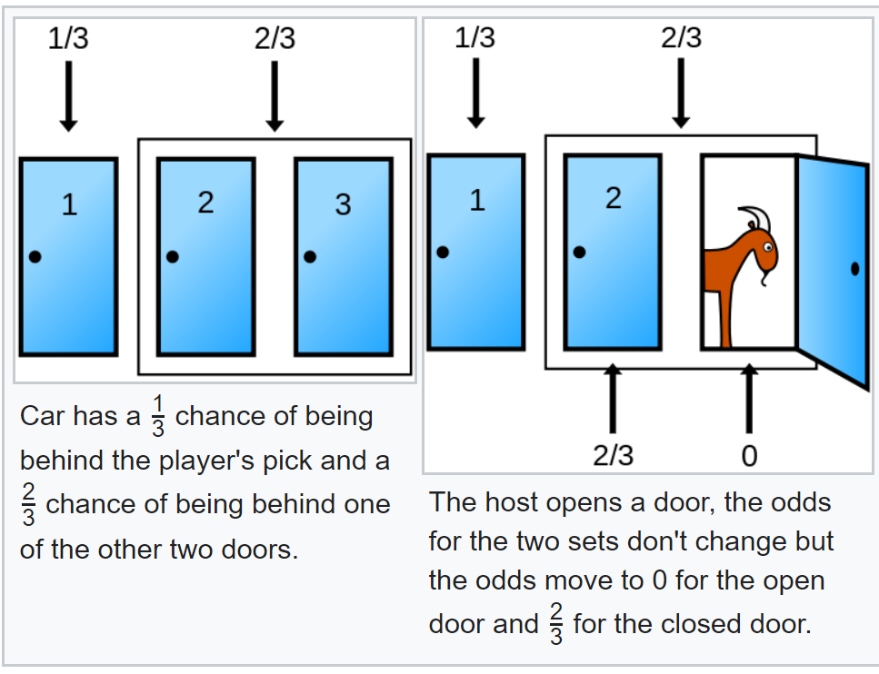
Simulation Example
Should the contestant stick with her initial choice, or switch to the other door? That is the Monty Hall problem.
The chance that the car is behind the originally chosen door is 1/3.
After Monty opens the door with the goat, the chance distribution changes.
If the contestant switches the decision, he/she doubles the chance.

Slide 23
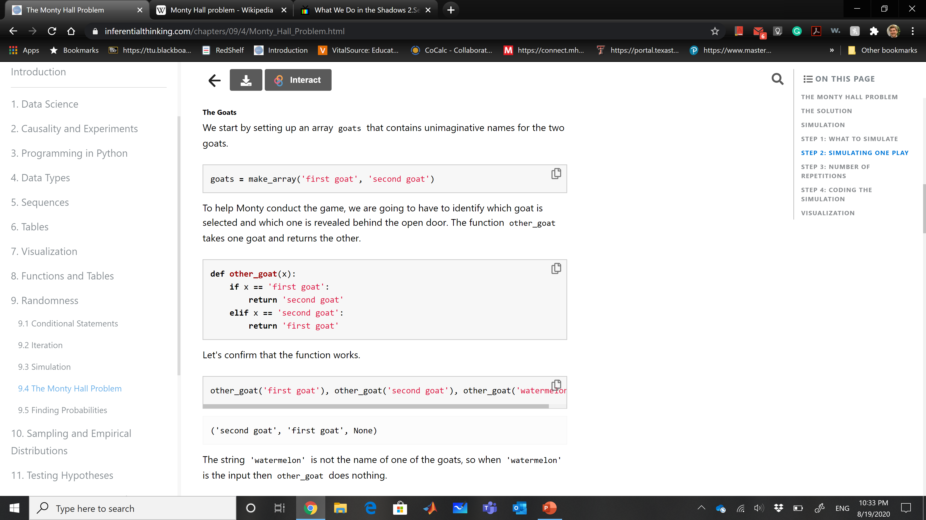

Simulation Example
Step 1 - What to Simulate: 3 Doors
First pick, Monty opens with goat, the remaining door.
Step 2 - Simulating One Play
We need to identify the goat that is not shown by Monty

Slide 24
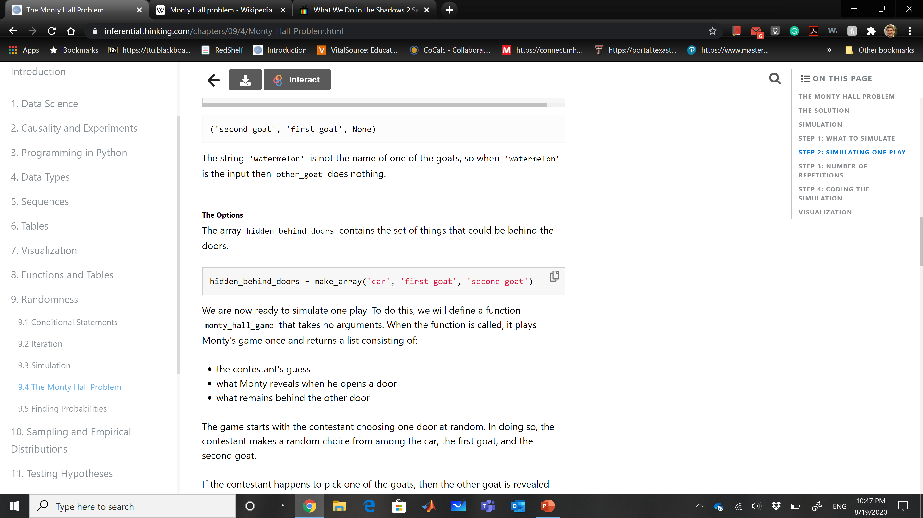
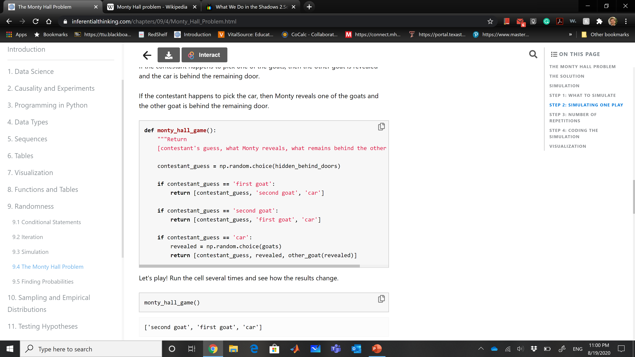
Simulation Example
Define the options:
Define the wrapping function monty_hall_game with no arguments.

Slide 25
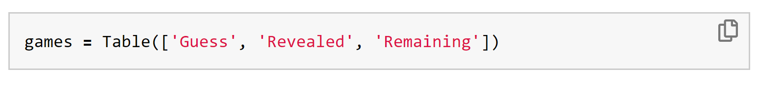
Simulation Example
First let's create a table games that has three empty columns.
Step 3: Number of Repetitions:
To check if the suggested increase of chace is right, we have to play the game many times and collect the results. Let's run 10,000 repetitions.
Step 4: Coding the Simulation:
One way to grow a table by adding a new row is to use the append method. If my_table is a table and new_row is a list containing the entries in a new row, then my_table.append(new_row).
First let's create a table games that has three empty columns.

Slide 26
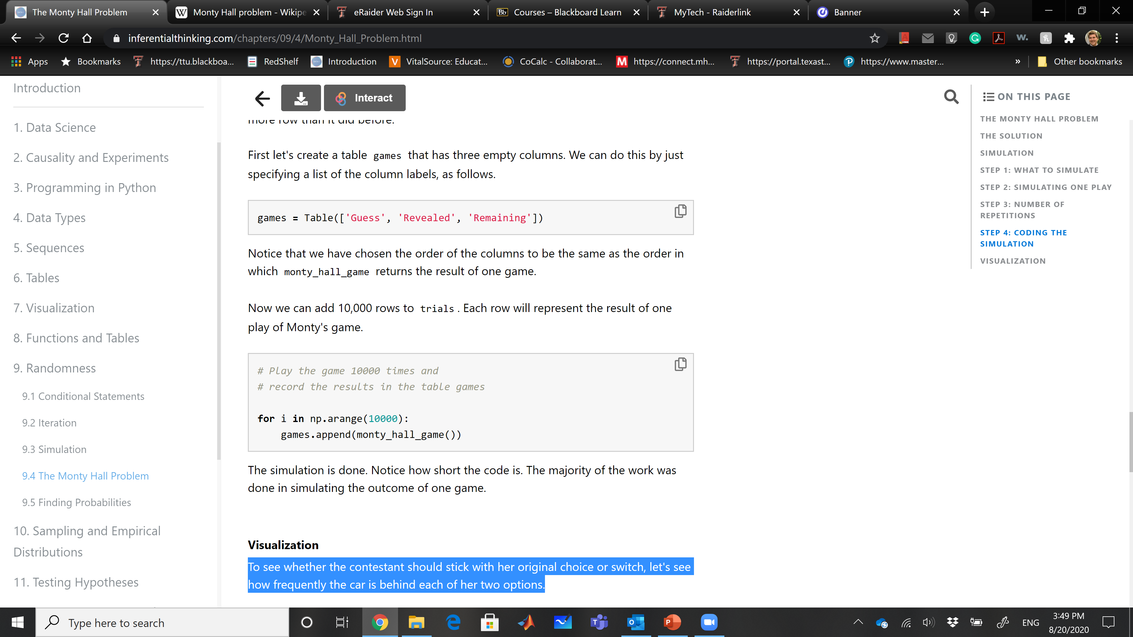
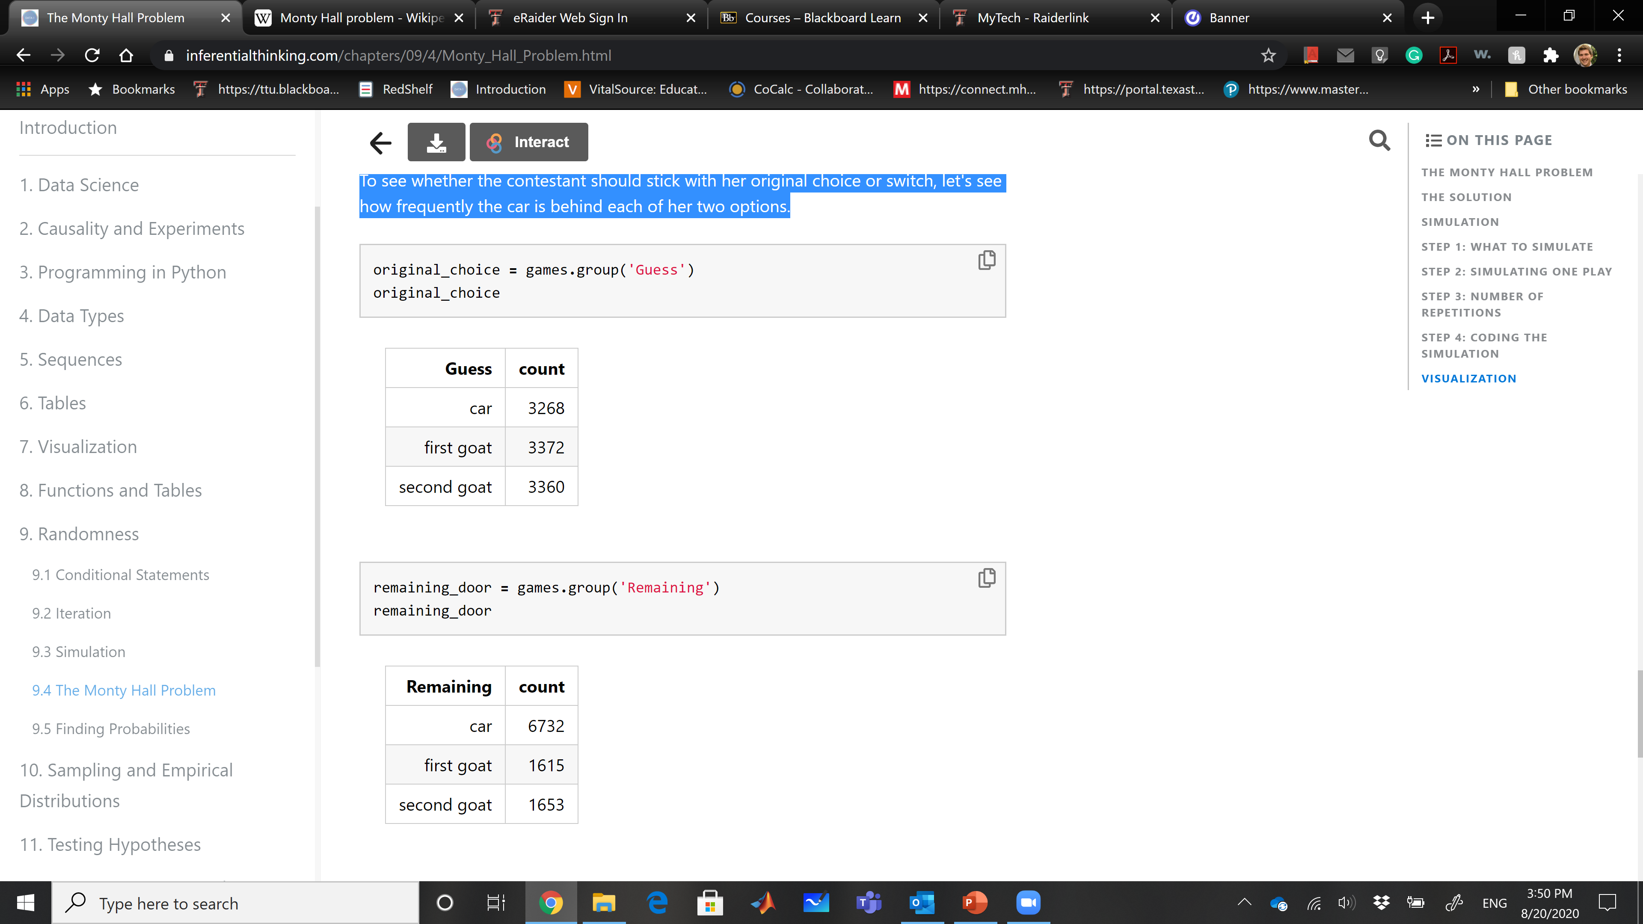
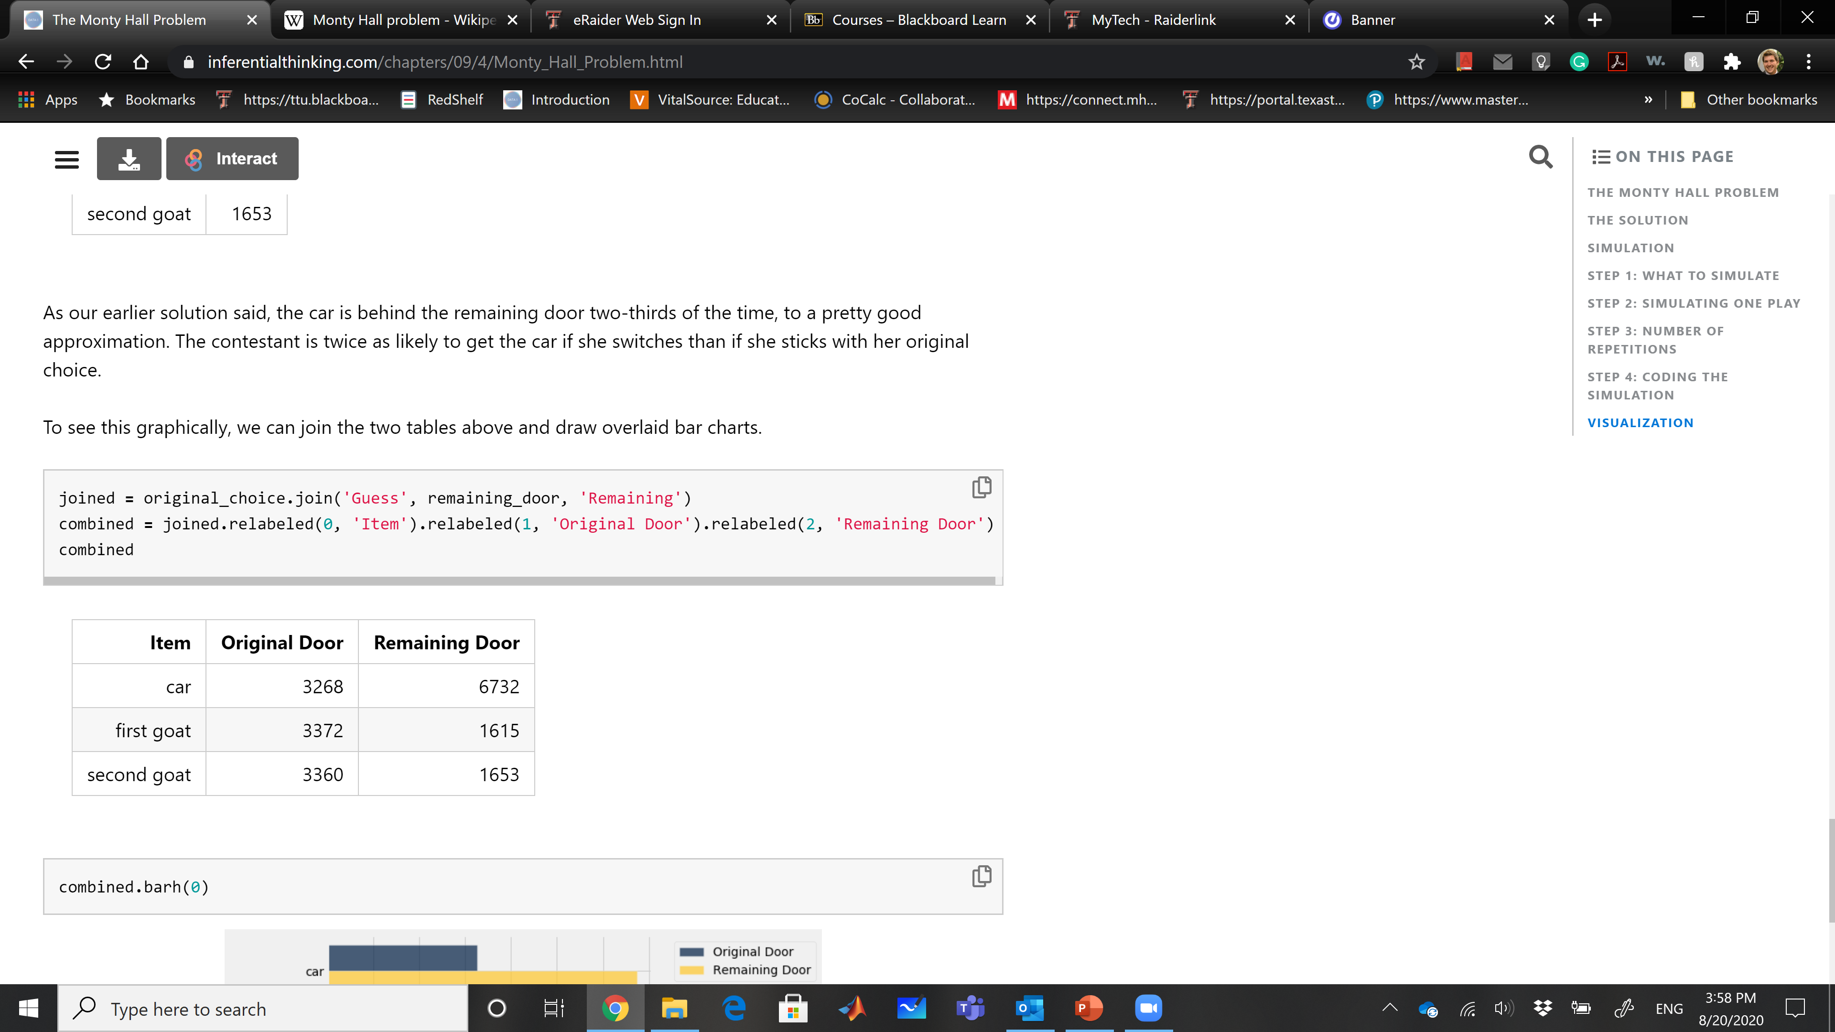
Simulation Example
First let's create a table games that has three empty columns.
Now we can add 10,000 rows to trials. Each row will represent the result of one play of Monty's game.
Visualization:
To plot, we can join the 2 tables above and draw bar charts.

Slide 27
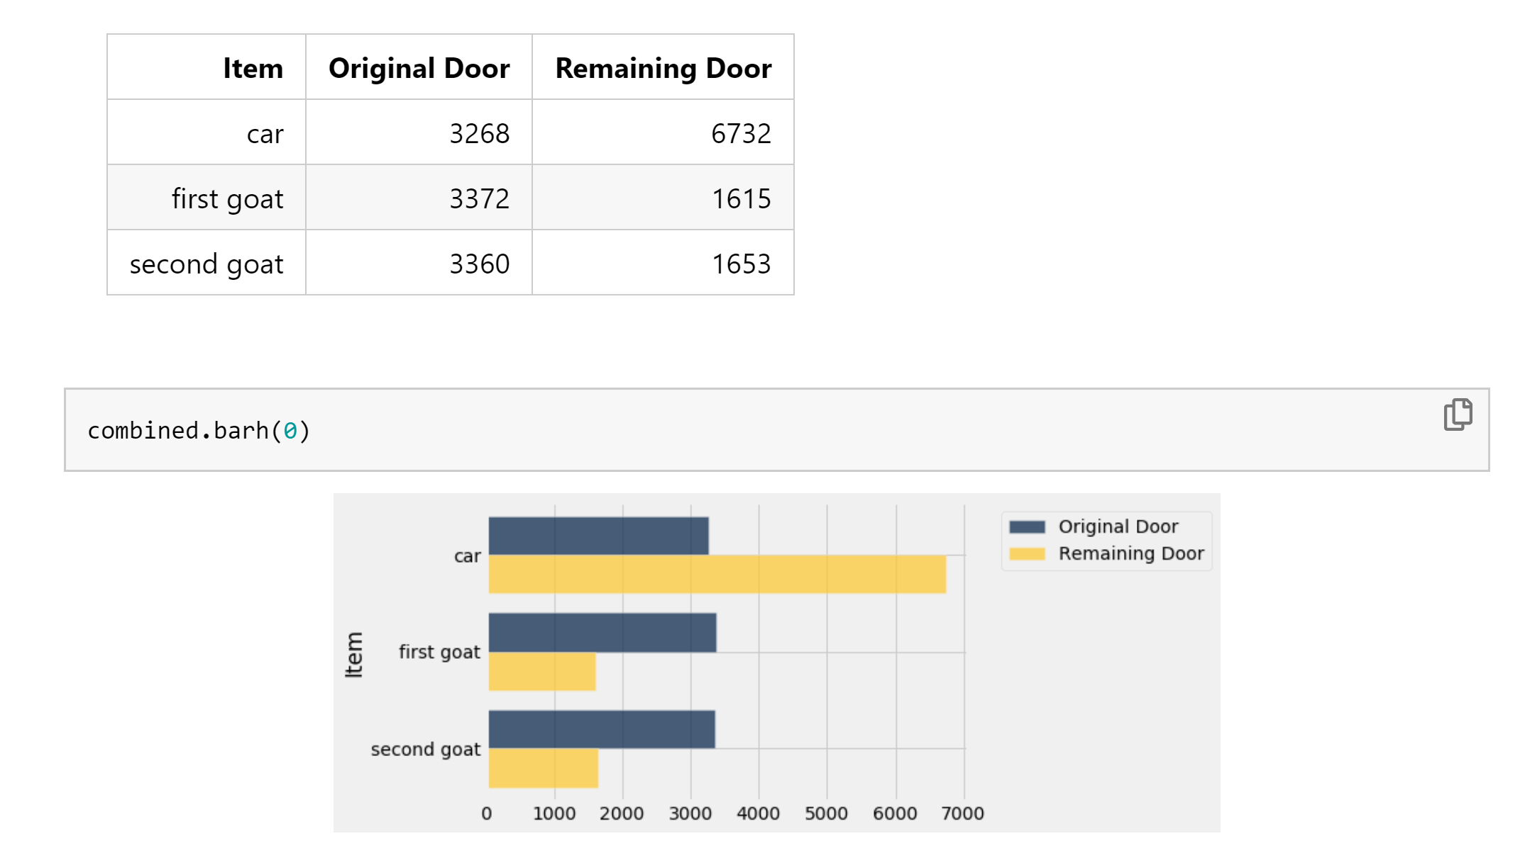
Simulation Example

